Slide 1

Linux Plus for AWS and DevOps

Slide 2
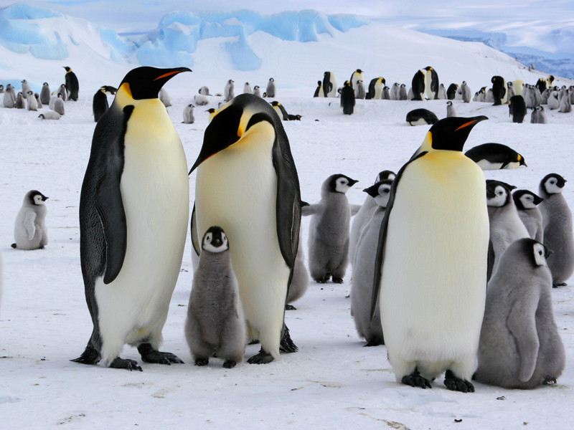
Managing Users and Groups

Slide 3
Table of Contents
sudo Command (recap)
Basic User Commands
User Management
User Passwords
Group Management

Slide 4



Did you finish pre-class work?
Notes:
Hard or Easy
Use this template to do a quick temperature check and self-reflection about the homework. You can learn which students might have struggled with the assignment and therefore might need more attention today.
🍐 This is a Pear Deck Draggable™ Slide.
🍐 To edit the type of question, go back to the "Ask Students a Question" in the Pear Deck sidebar.

Slide 5
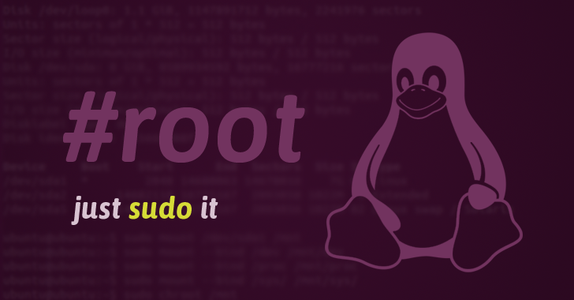
“sudo” command
1

Slide 6
sudo Command
The sudo (superuser do) command gives some admin privileges to non-admin users.
When you put sudo in front of any command in terminal, that command runs with elevated privileges.
If you're not sure if you're using sudo or su, look at the trailing character on the command line. If it's a pound sign (#), you're logged in as root.

Slide 7
sudo Command
Commands | Meaning
sudo -l | List available commands.
sudo command | Run command as root.
sudo -u root command | Run command as root.
sudo -u user command | Run command as user.
sudo su | Switch to the superuser account.
sudo su - | Switch to the superuser account with root's environment.
sudo su - username | Switch to the username's account with the username's environment.
sudo -s | Start a shell as root
sudo -u root -s | Same as above.
sudo -u user -s | Start a shell as user.

Slide 8
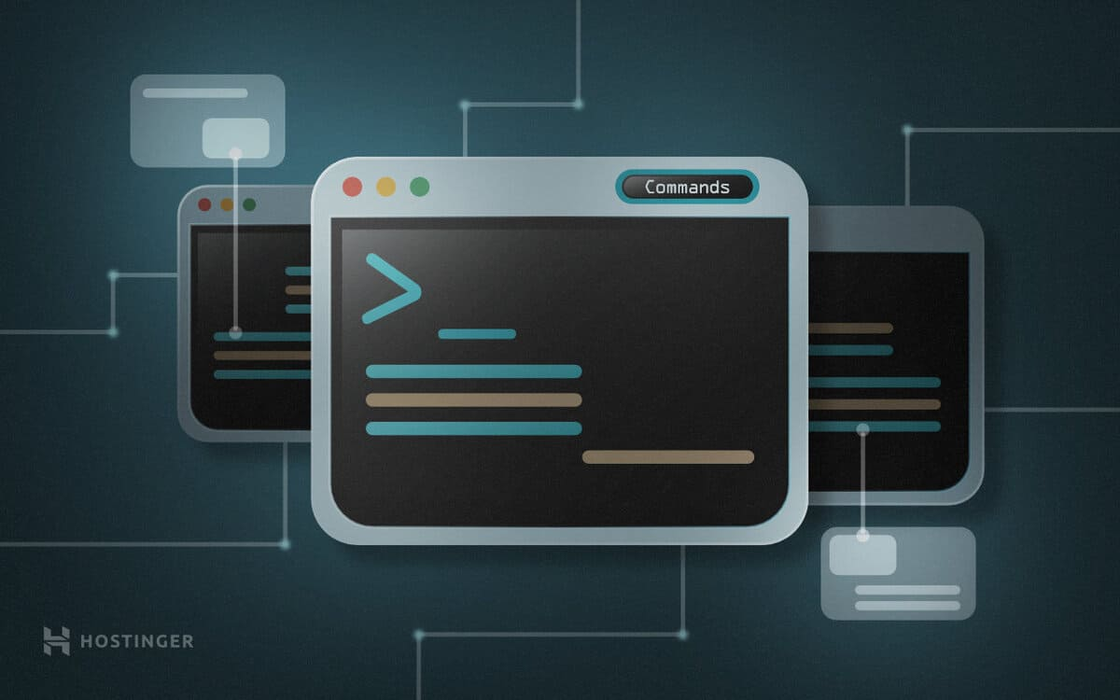
Basic User Commands
2

Slide 9
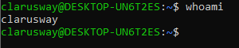
Basic User Commands
display one-line manual page descriptions.
whoami
whoami

Slide 10
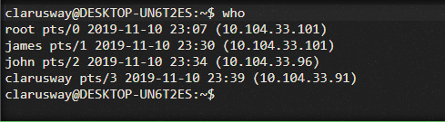
Basic User Commands
provide with details about who is logged on the system.
who
who

Slide 11
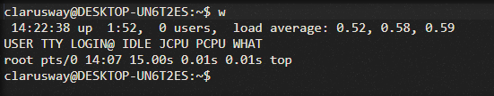
Basic User Commands
inform who is logged on and what they are doing.
w
w

Slide 12
Basic User Commands
Display user id, your primary group id, and a list of the groups you belong to.
id
id [username]

Slide 13
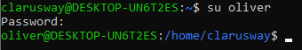
Basic User Commands
enables a shell to be run as another user.
su
su [username]

Slide 14
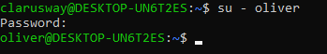
Basic User Commands
To become another user and also get the environment of the target user.
su -
su - [username]

Slide 15
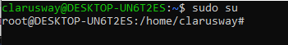
Basic User Commands
The root user does not have a password set on some Linux systems like Ubuntu and Xubuntu. On these Linux systems, You can become root user via sudo su command.
sudo su
sudo su
sudo su -

Slide 16
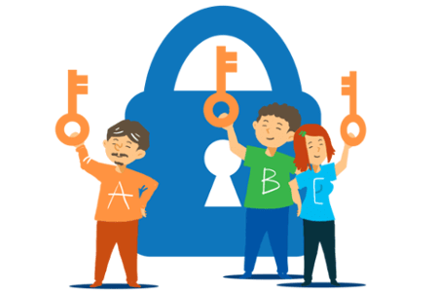
User management
3

Slide 17
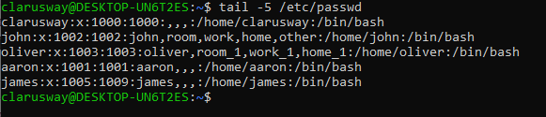
User management
On Linux, the local user database is /etc/passwd.
etc/passwd

Slide 18
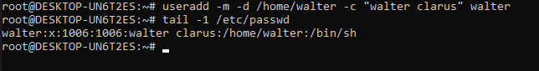
User management
useradd command is used for creating a new user.
useradd
useradd [username]
-m is used for forcing the creation of the home directory
-d is used for setting the name of the home directory
-c is used for setting a description

Slide 19
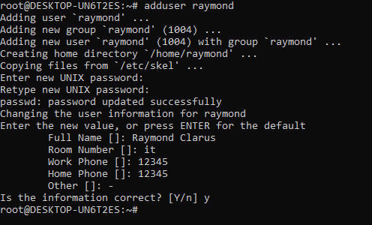
User management
adduser is not a standard Linux command. It’s basically a Perl script that uses the useradd command in the background. This is more effective at creating new users on Linux.
adduser
adduser [useradd]

Slide 20
User management
Delete a user. userdel command will not remove the user's home directory from the file system. If you want to remove the home directory, you need to use the -r in the command line.
userdel
userdel [username]

Slide 21
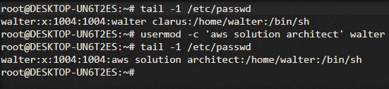
User management
Modify a user's properties. The example below modifies the description of the user walter.
usermod
usermod -[option] [value] [username]

Slide 22
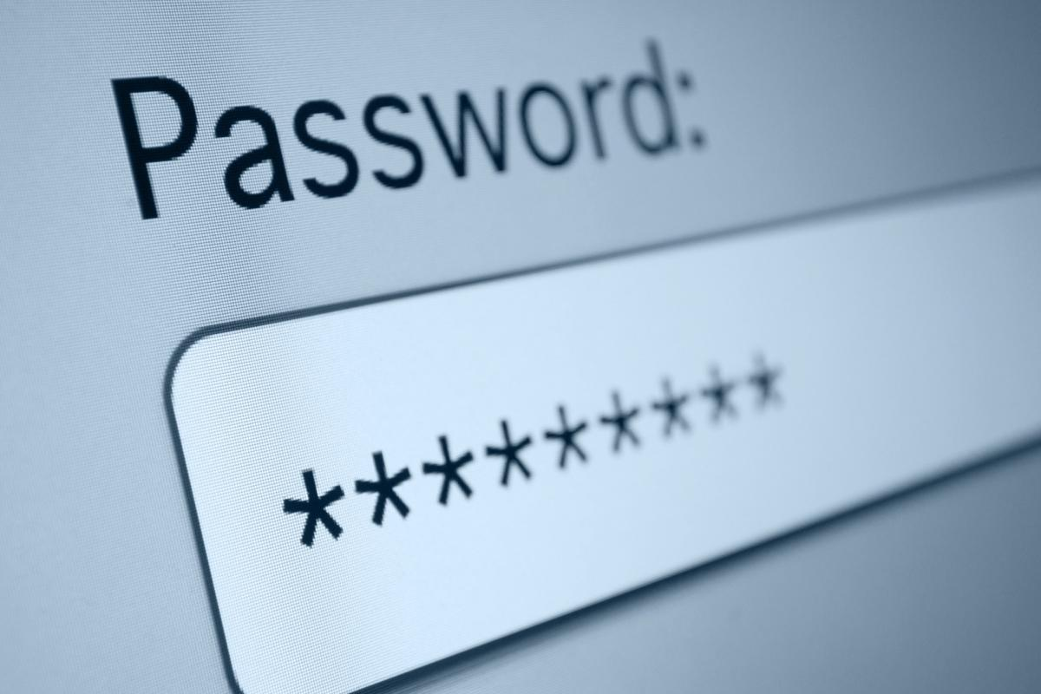
User Passwords
4

Slide 23
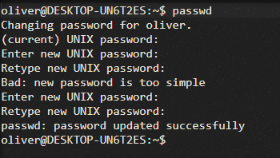
User Passwords
User passwords can be set with the passwd command.
passwd
passwd [username]

Slide 24
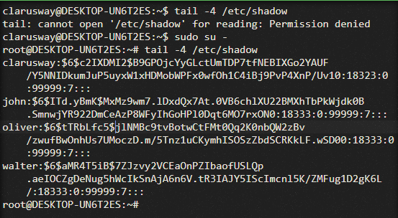
User Passwords
User passwords are encrypted and stored in /etc/shadow file.
The /etc/shadow file is only read and can be accessed by root only.
etc/shadow

Slide 25
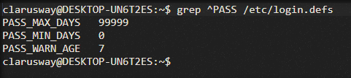
User Passwords
The /etc/login.defs file includes some default user password settings, such as password aging and length settings.
etc/login.defs

Slide 26
Exercise
Create a user named devops
Set devops user password as clarusway
Change devops user description as the best cloud engineer
Switch to devops user
Display information of devops user
Go back to previous user
Delete devops user with home directory
Notes:
🍐 This is a Pear Deck Text Slide
🍐 To edit the type of question, go back to the "Ask Students a Question" in the Pear Deck sidebar.
useradd devops
passwd devops
usermod -c “the best cloud engineer”
sudo su devops
tail -1 /etc/passwd
exit
userdel -r devops

Slide 27

Group Management
5

Slide 28
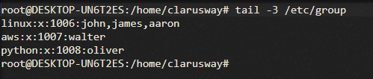
Group Management
Users can belong to several groups. Group membership is specified via the /etc/group file.
etc/group

Slide 29
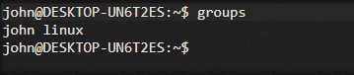
Group Management
groups command is used to display a list of groups to which the user belongs.
groups
groups [username]

Slide 30
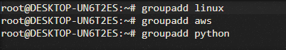
Group Management
groupadd command is used to create a new group.
groupadd
groupadd [groupname]

Slide 31
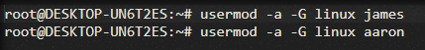
Group Management
You can change group membership with the usermod command.
usermod
usermod -a -G [groupname] [username]
By default, if the group is not specified in the command, the usermod command will remove the user from any group!
Using the -a (append) option prevents this behaviour.

Slide 32
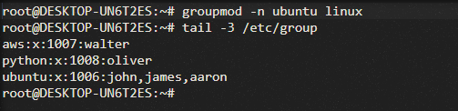
Group Management
groupmod command can be used to change the group name.
groupmod
groupmod -n [newname] [oldname]

Slide 33
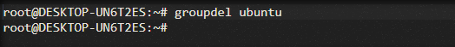
Group Management
groupdel command is used to delete a group.
groupdel
groupdel [groupname]

Slide 34
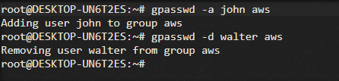
Group Management
With the gpasswd command, we can add a user to a group and to remove a user from a group. In the example below:
We add john to aws group with gpasswd -a command.
We remove walter from aws group with gpasswd -d command.
gpasswd
gpasswd -[option] [username] [groupname]

Slide 35
Exercise
Create a user named devops
Create two groups named cloud and aws
Add devops user to the group cloud
Display groups that devops user belongs to
Add devops user to the group aws
Remove devops user from cloud group
Delete cloud group
Rename aws group name as aws-cloud
Display groups that devops user belongs to
Notes:
🍐 This is a Pear Deck Text Slide
🍐 To edit the type of question, go back to the "Ask Students a Question" in the Pear Deck sidebar.
useradd devops
groupadd cloud
groupadd aws
gpasswd -a devops cloud
groups devops
gpasswd -a devops aws
gpasswd -d devops cloud
groupdel cloud
groupmod -n aws-cloud aws
groups devops

Slide 36


Slide 37
Exercise
Create users: Jason, Bruce, Victor, Mark, Jack, Tyler, Tomy, Edward, Eric
Create groups: Asia, Europe, America, Africa
Add users: Jason, Bruce, Victor to the Asia group
Add users: Jason, Mark, Jack, Tyler to the Europe group
Add users: Jason, Tomy, Edward to the America group
Add users: Jason, Bruce, Mark, Edward, Jack, Tyler, Eric to the Africa group
Display groups that Jason belongs to; Display groups that Edward belongs to
Remove Bruce from Africa group; Remove Jason from all groups
Delete Europe group
Rename Africa group as Australia
Notes:
homework

Slide 38
THANKS!
Any questions?

